Slide 1
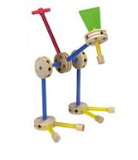
Low Cost FPGA Boards their tools & course material
James Brakefield jim.brakefield@ieee.org
IEEE Computer Society

Slide 2
Considerations
It is thought that ownership of an FPGA board will lead to greater usage and knowledge. As opposed to shared laboratory equipment. Something that can easily be carried in a backpack and always available.
If you disagree with FPGA board choice, a spreadsheet gives sufficient info to make your own choice.
Oriented towards a beginner’s board at low cost. Lots of switches, LEDs etc. eliminate need for discrete components and their fragile wiring.
Academic prices shown where available.
These slides & spreadsheet at: https://events.vtools.ieee.org/m/306653

Slide 3
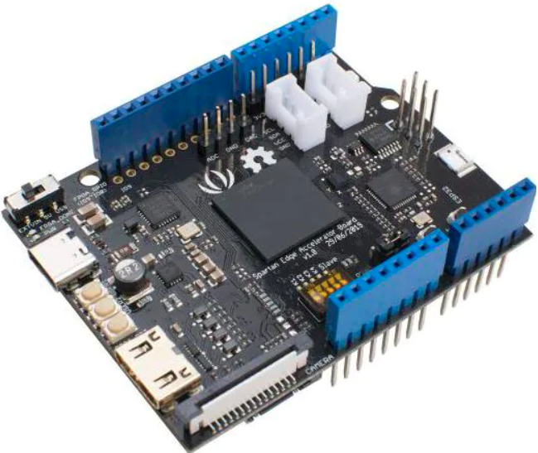
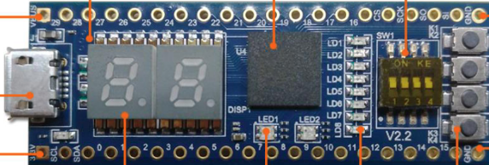
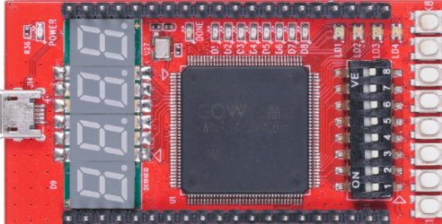
Under $40 & some built-in IO
StepFPGA MAX10 dev board $39
Seeedstudio Spartan-7 Edge
Accelerator board $40
Seeedstudio
Gowin RUNBER $30
Notes:
Replaced Campus-FPGA with Gowin RUNBER. 4 digit 7-seg with 5 PB Arduino shield for Edge Accelerator $9 (uses I2C).

Slide 4
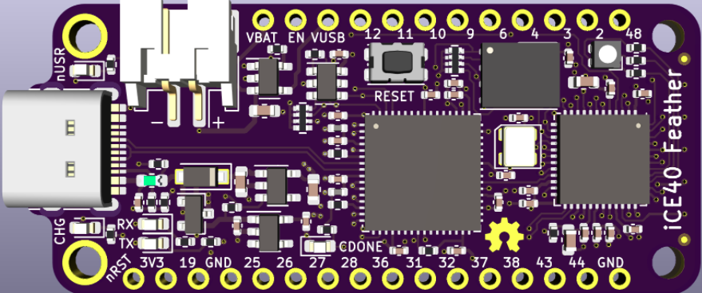
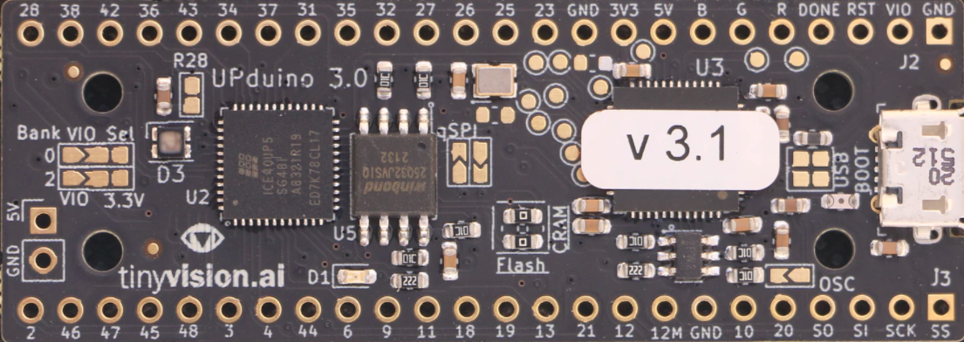
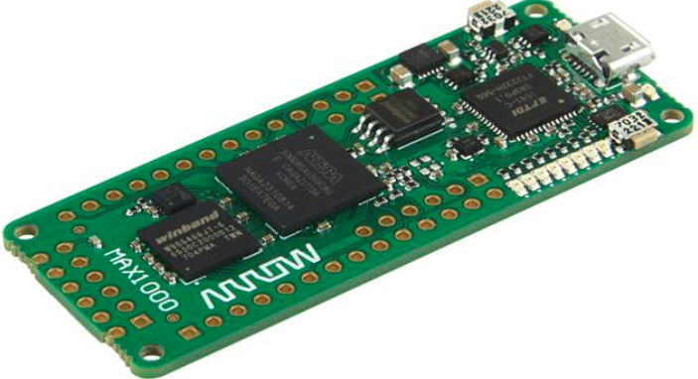
Very little built-in IO $25-30
iCE40
Feather
Has battery
support
Trenz MAX-1000
Has 8MB ram
UPDuino v3.1
Notes:
Many more like these available. See: https://www.joelw.id.au/FPGA/CheapFPGADevelopmentBoards with boards sorted by FPGA family.

Slide 5
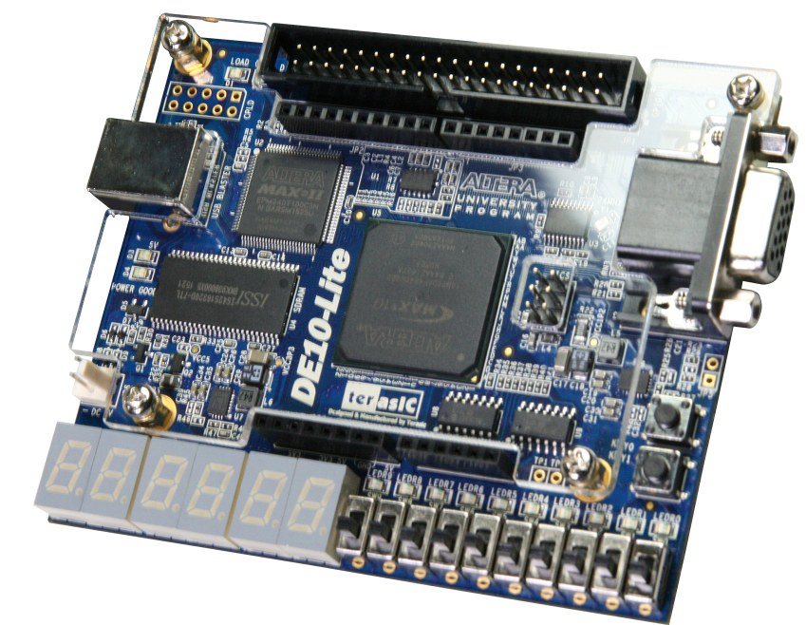
DE10-Lite board $77
Notes:
Only has two push buttons (AKA “tact” switches). Has Arduino connectors. SRAM & SD card slot facilitates use of Intel/Altera NIOS-II soft processor. Academic price shown.

Slide 6
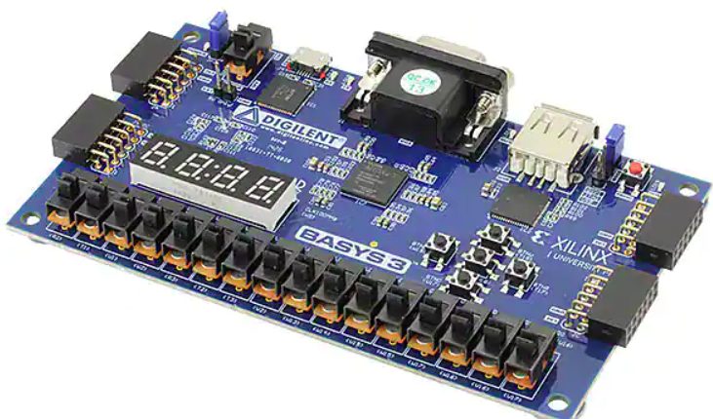
Basys 3 Artix-7 $112
Notes:
Has push buttons in “navigation” configuration. Academic price shown.

Slide 7
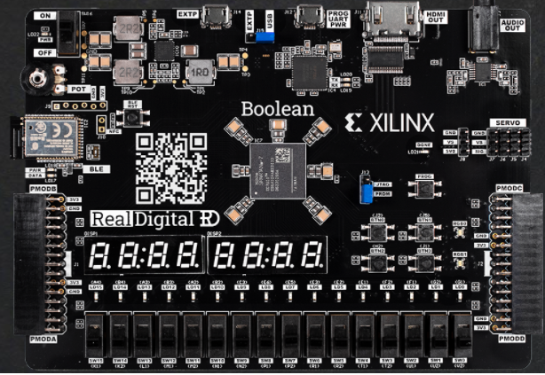
Boolean board $69
Notes:
Available with or without Bluetooth LE. Only four user push buttons. Shown on Xilinx University program web page. Winning features are servo headers & potentiometer. The staggered IO holes is deliberate, will hold and connect headers without soldering “temporarily”.

Slide 8
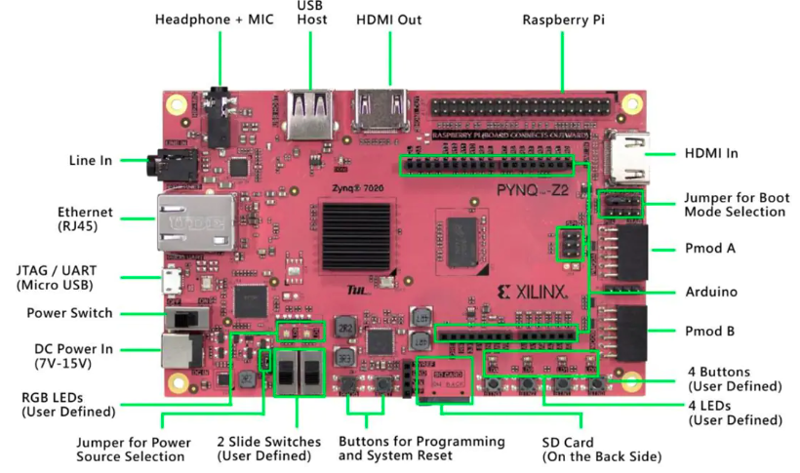
PYNQ-Z2 $123 at Newark (for the more advanced user)
FPGA boards with microprocessor cores typically use serial terminal
for user IO and thus fewer switches, buttons & LEDs needed
Notes:
FPGA board with two ARM A9 cores. Available at RealDigital and Newark. See http://www.pynq.io for it’s software infrastructure!

Slide 9
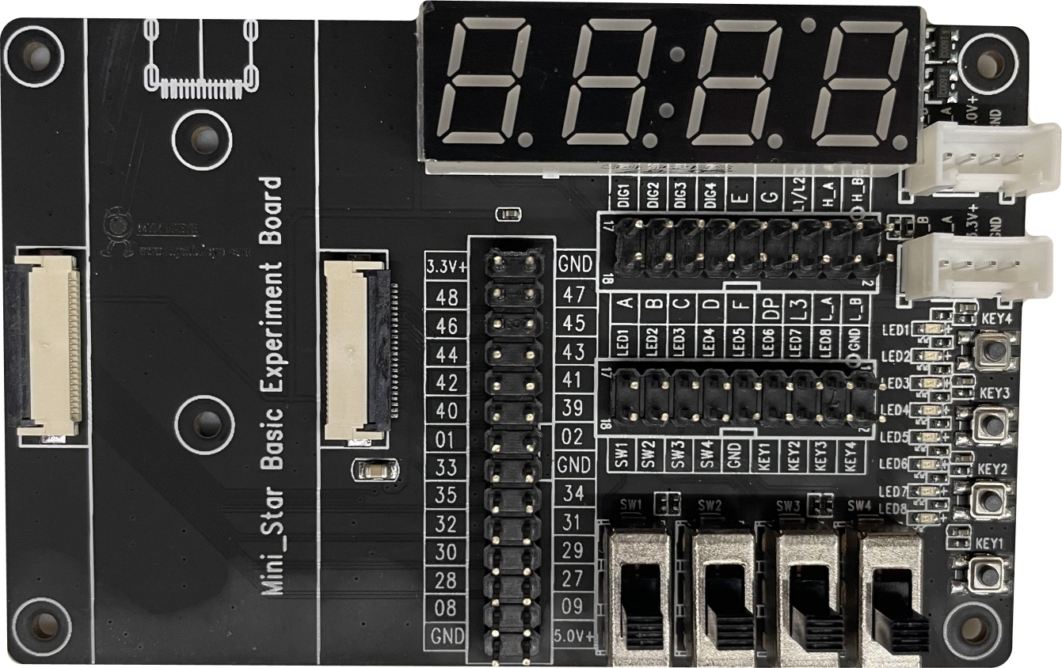
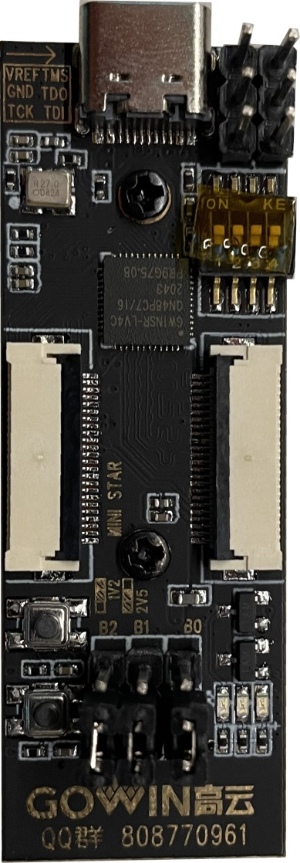
MiniStar experiment kit $69 Gowin FPGA with ARM Cortex M3
Notes:
Available at Amazon for $69. 4K LUTs, 8MB SRAM. Kit Has connection cables. 4 slide & 4 DIP switches, 6 PB, 12 LED, 2 Grove connectors, and the four digit 7-segment display.

Slide 10
Built-in IO Done Just Right
10+ slide switches and/or DIP switches
5+ push buttons
10+ LEDs, two tri-color (RGB)
7-segment LEDs (four to eight digits)
VGA or HDMI connector
Expansion IOs (Arduino, Pi, DIP pattern…)

Slide 11
Nice to have built-in IO
Potentiometer or incremental encoder
Servo connector(s)
Navigation switch or rhombic push button pattern
Pmod connector(s)
Grove connector(s)
Built-in microprocessor
SRAM or DRAM for microprocessor memory
SD socket for microprocessor operating system
Notes:
The servo connectors make for a robotics capable board. Usage model for potentiometer is showing the voltage on the 7-segment display.

Slide 12
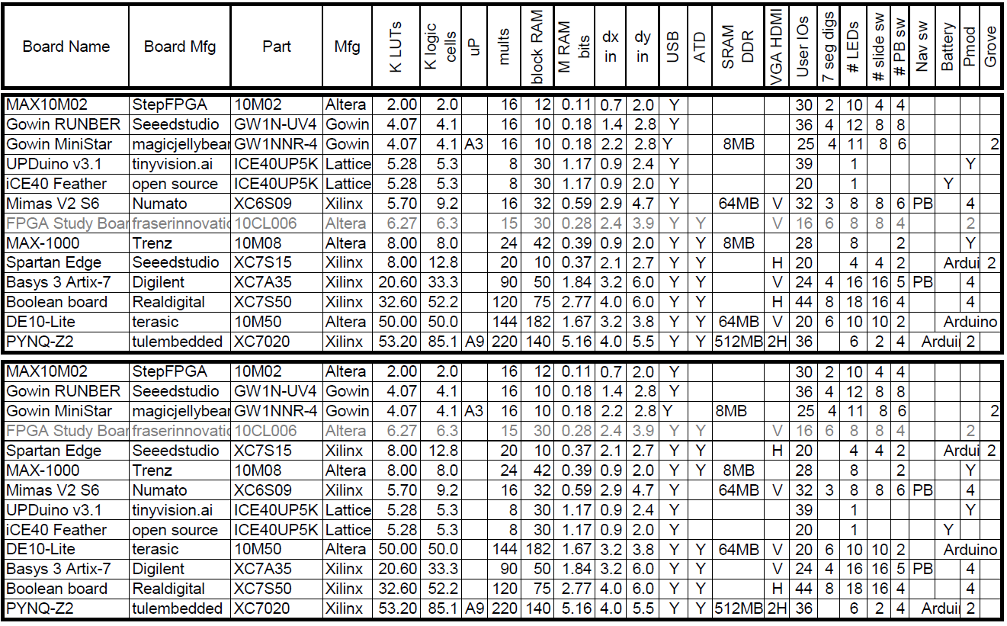
FPGA board rankings
Top version sorted by LUT count, bottom version by block RAM bit count
This listing is only a sample of the hundreds of boards available.
Notes:
The spreadsheet at https://events.vtools.ieee.org/m/306653 has a sheet with a long somewhat dated list sorted by FPGA family. Also a sheet sorted by shape. ATD: analog to digital converter. LUT: logic lookup table. Block RAM: typically dual ported, adjustable aspect ratio.

Slide 13
Educational programs
Intel/Altera academy Quartus: RTL & Schematic
AMD/Xilinx university program ISE & Vivado RTL tools
Courseware for Realdigital Boolean board RTL
https://www.realdigital.org/course/digital-logic-for-the-boolean-board
https://www.tina.com/ (Schematic based)
Support for the Digilent Basys 3 and the Terasic DE10-Lite FPGA boards
https://www.tina.com/blog/programming-fpga-boards-with-tina-using-schematic-design-entry/
Digital logic simulator (Schematic based)
Support for the Digilent Basys 3 and the TinyFPGA-BX boards
Have added support for the RealDigital.org Boolean Board
https://github.com/hneemann/Digital/
Notes:
RTL: Register transfer language, usually VHDL or Verilog. Quartus and Vivado are mainstream tools with free education variants (reduced FPGA family support). Tina tools are not free, are for the education market in 25 languages.

Slide 14
Intel/Altera academic program
https://www.intel.com/content/www/us/en/developer/topic-technology/fpga-academic/overview.html
https://www.intel.com/content/www/us/en/developer/topic-technology/fpga-academic/materials.html
https://fpgacademy.org/tools.html
DE10-Lite academic price $77

Slide 15
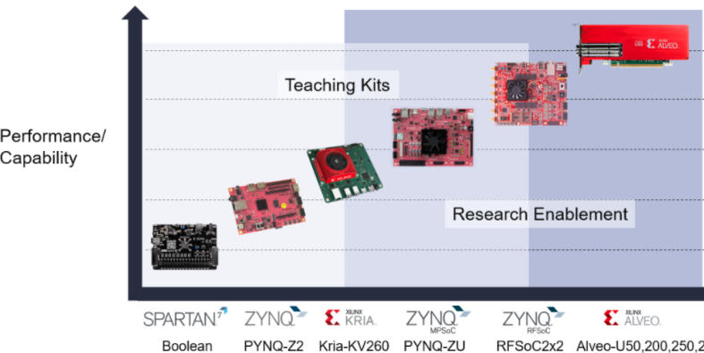
Xilinx university program
https://www.xilinx.com/support/university.html
https://www.xilinx.com/support/university/boards-portfolio/xup-boards/RealDigitalBoolenBoard.html
$69 $123 $200
$549
$2149
Notes:
Boolean Board “endorsement” by Xilinx. Kria-KV260 has state-of-the-art FPGA. Academic prices shown.

Slide 16
Conclusions
It appears readily possible to configure Digital logic simulator to almost any FPGA board.
Would help beginning users if there was automation to run the design flow from schematic entry to FPGA download.
DE10-Lite and Basys 3 Artix-7 widely used.
Boolean Board beats Basys 3 on price and built-in IO.
DE10-Lite has somewhat inadequate built-in IO.
A board using a minimal cost FPGA chip with adequate built-in IO would be useful for connecting to FPGA boards with limited “built-in” IO. Could be a student chapter project?
Notes:
Original plan was to do a simple built-in IO board for connection to a limited IO FPGA board; with the Boolean board a separate simple IO board is unnecessary.

Slide 17
Gotchas
Inflation & chip shortages
FPGA news & surprises
Raspberry Pi FPGA board?
New “educational” FPGA boards appearing often
Open source FPGA tools support a limited set of FPGA chips (Artix-7, ICE40 & ECP5).
Board usage requires PC (Windows or Linux)
Xilinx Vivado requires 70+ GB disk space
Notes:
Open source FPGA tools: https://symbiflow.github.io/ & https://hackaday.com/tag/fpga-toolchain/ Logic simulators: https://hackaday.com/2021/06/10/survey-of-simple-logic-simulators/

Slide 18
FPGA Application Areas
Communications
DSP
Software-defined radio
Aerospace and defense systems
ASIC prototyping
Medical imaging
Computer vision
Speech recognition
Cryptography
Bioinformatics
Computer hardware emulation
Data Center: AI, NN, big data
Advantages:
Outstanding Job market
Disadvantages:
Tough learning curve

Slide 19
Low End Applications
1.5-3mm pkg, 2K LUTs
.1Mb block RAM
Glue logic Connection of disparate devices to a uP
Last minute patches
Logic funnel Legacy design re-hosting
IP: pre-packaged modules
Soft core processors & peripherals (www.opencores.org)
20K LUTs, 40 DSPs,
1Mb block RAM

Slide 20
Mid-scale Applications
200K LUTs, 1K DSPs,
15Mb block RAM
Communications: Internet routers, Telephone switches, Protocol conversion
Signal Processing: Software defined radio, Camera, Audio, Video, Radar …
Test & Measurement: high speed A2D & D2A,
Big science: Super-collider, SETI, etc.
Aerospace: radiation hardened, military temperature range
SOC (System On a Chip): driverless vehicles

Slide 21
High End Applications
Up to 4M 6LUTs, 12K DSPs,
700Mb block RAM, 2GB HBM
ASIC (Applications Specific Integrated Circuit) emulation
High end weapons, who knows what else?
Super-computing coprocessor
Intel bought Altera, AMD bought Xilinx
Wall street (high frequency trading)
AI/deep NN/data center acceleration
Notes:
Current maximum FPGA capabilities: 4M 6LUT, 12K DSP, 700Mb block RAM, 32GB DRAM. Biggest parts use multiple die in same package. HBM: High bandwidth memory.

Slide 22
The chip manufacturers
Xilinx (now AMD): www.xilinx.com
Originated FPGAs with help from AMD
Altera (now Intel): www.altera.com
Originally CPLDs, #2 in FPGAs.
Microsemi (was originally Actel): www.microsemi.com/product-directory/1636-fpga-soc
SRAM & flash based
Lattice Semiconductor: www.latticesemi.com
Offer tiny FPGA chips
Quicklogic: www.quicklogic.com
ARM + ~2K LUTs
Gowinsemi: https://www.gowinsemi.com/en/

Slide 23
References
Three Ages of FPGAs: A Retrospective…, Steve Trimberger, Proc. IEEE v103#3p318, 2015
www.cpe.virginia.edu/grads/pdfs/January%202016/VLSI.pdf
https://www.youtube.com/watch?v=4ntXSyOhlBY
Xilinx Part Family History, John Lazzaro,
www-inst.eecs.berkeley.edu/~cs294-59/fa10/resources/Xilinx-history/Xilinx-history.html
Altera History, corporate, http://www.fundinguniverse.com/company-histories/altera-corporation-history/
www.altera.com/about/company/history.html
Low cost FPGA boards
https://www.joelw.id.au/FPGA/CheapFPGADevelopmentBoards
Open source IP https://opencores.org/projects
Notes:
Intel removed Altera history web page.

Slide 24
Request for support
Boolean Board built-in IO support for Digital logic simulator (done):
LEDs, Slide switches, Push buttons, 100MHz clock
Seven segment digit multiplexer & hex decode
Potentiometer IP (per Realdigital tutorial)
HDMI IP (per Realdigital tutorial)
Modify: Digital/examples/hdl/BASYS3.config
E.g. copy & rename to Boolbd.config
Per: Digital/examples/hdl/HowTo.md
Copy, edit and rename BASYS3_IOs.dig to Boolbd_IOs.dig
Automation of: schematic -> FPGA download
Customized course materials
Notes:
Also possible: IEEE Student chapters help students with Boolean Board usage?

Slide 25
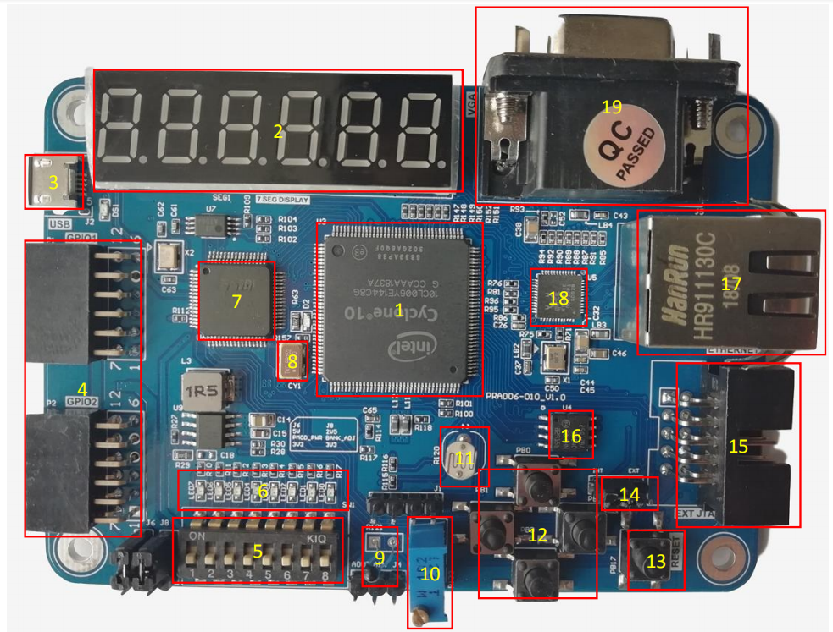
Altera FPGA Study Board $59 & $69
Notes:
Meets most of the Built-in IO “requirements”, has tutorials, LUT count is relatively low but adequate, one could replace potentiometer(#10) with single turn version. Unable to interact with web page. Phone number does not work.

Slide 26
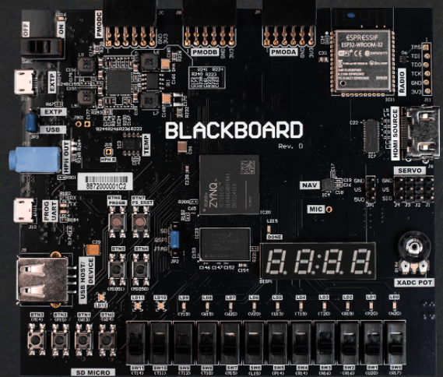
Blackboard $136
Notes:
Included to show a board with slightly less built-in user IO, has ESP32 WiFi and DRAM. Many, many other Zynq boards available (at similar or greater prices). Zyng FPGA has one or two ARM Cortex A9 cores

